Slide 1
Class 6 Social And Political Life(POLITY) Chapter-1 Understanding Diversity

Slide 3
Let’s have some examples-
Do we draw the things very similar to our friend’s drawing?
Do we have the similar names in class room?
Do our friends look similar to each other?

Slide 4
If your answer is ‘yes’, then what?

Slide 5
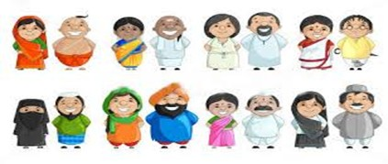
Different dresses people wear in different States. Which one is your favourite?

Slide 6
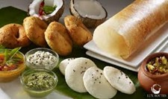
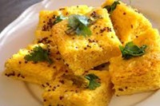
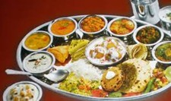
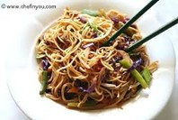
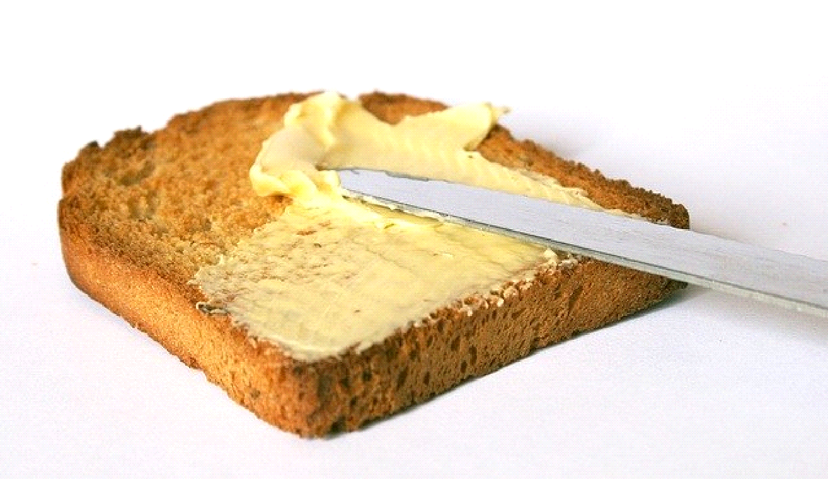
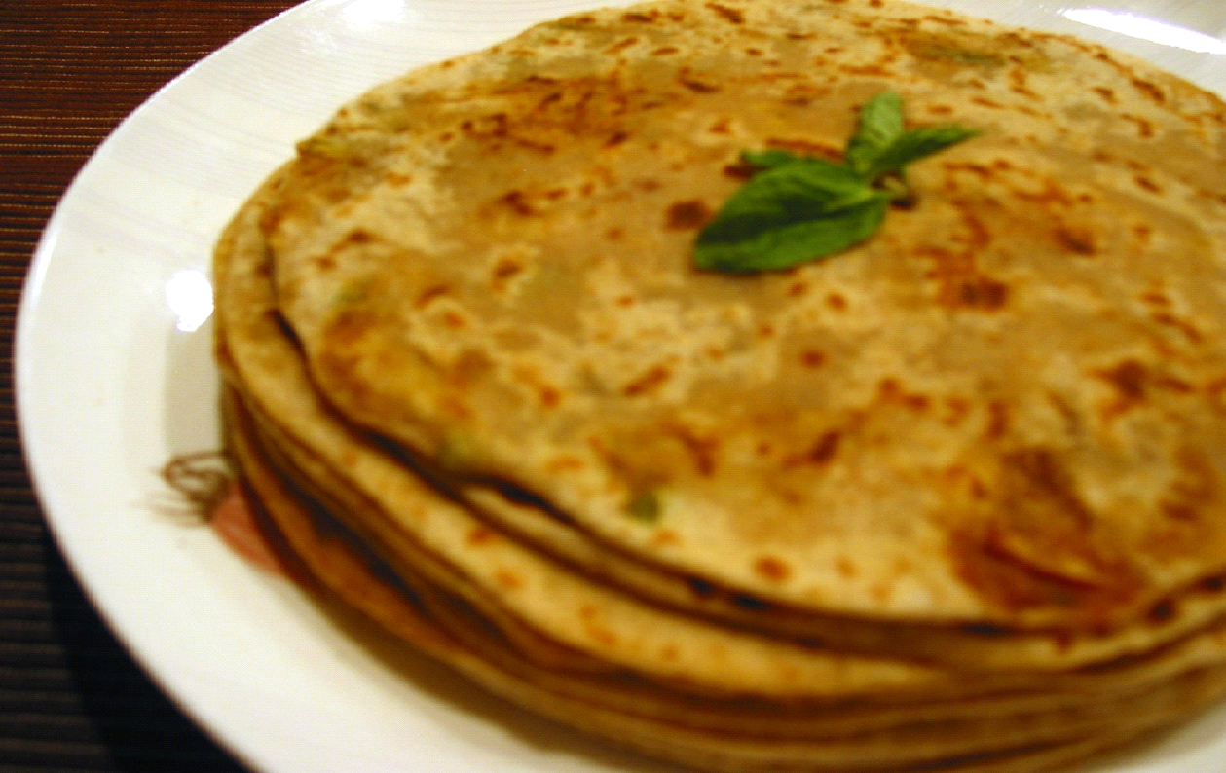
Which one is your favourite food?
Umm...you would not like to eat same food everyday.

Slide 7
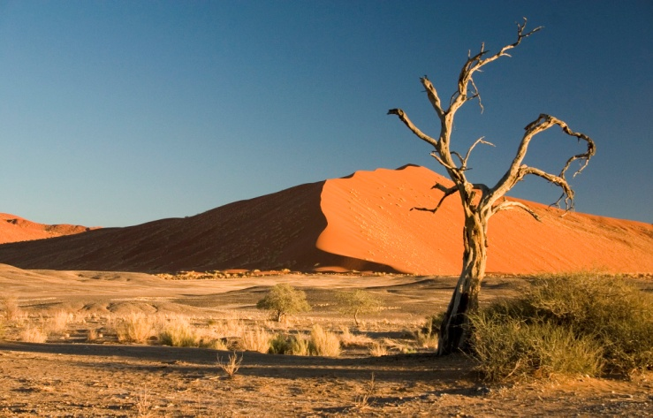
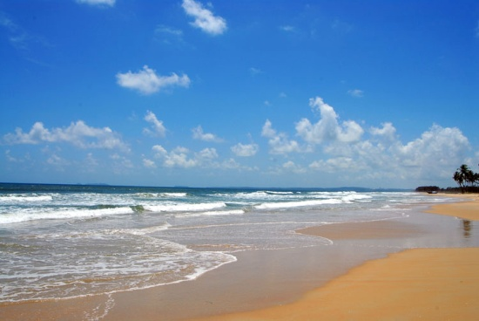
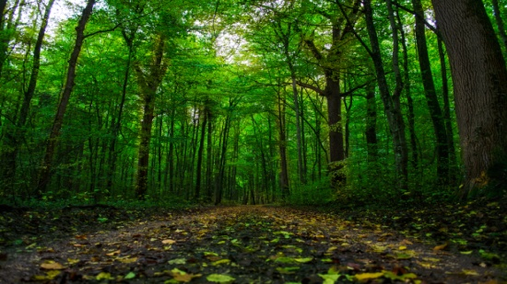
Where do you want to go in your vacation? Not always in same area.

Slide 8
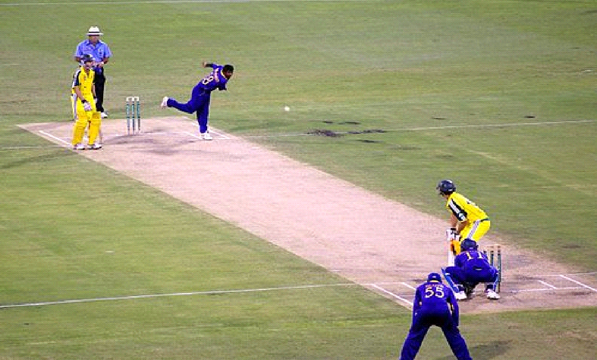
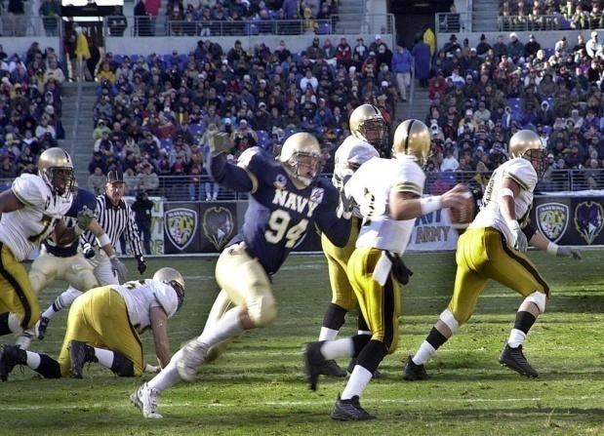
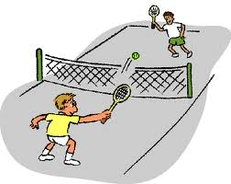
What games you and your friends play in school?

Slide 9
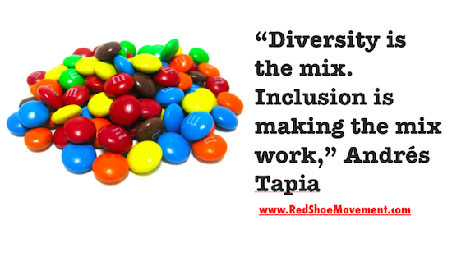
So now define “DIVERSITY”

Slide 10
DIVERSITY
Diversity denotes the cultural differences that exists between people, such as language, dress and traditions, there are also significant variations in the way society organise themselves, in their shared conception of morality, and in the way they interact with their environment.

Slide 11
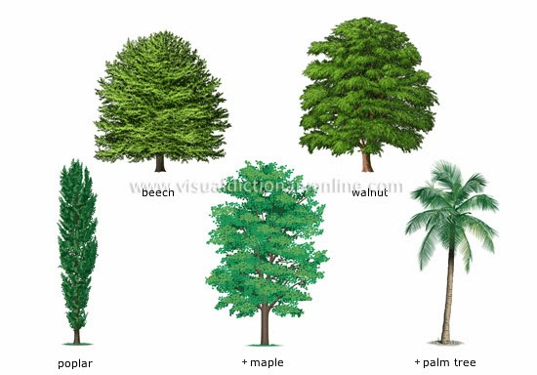
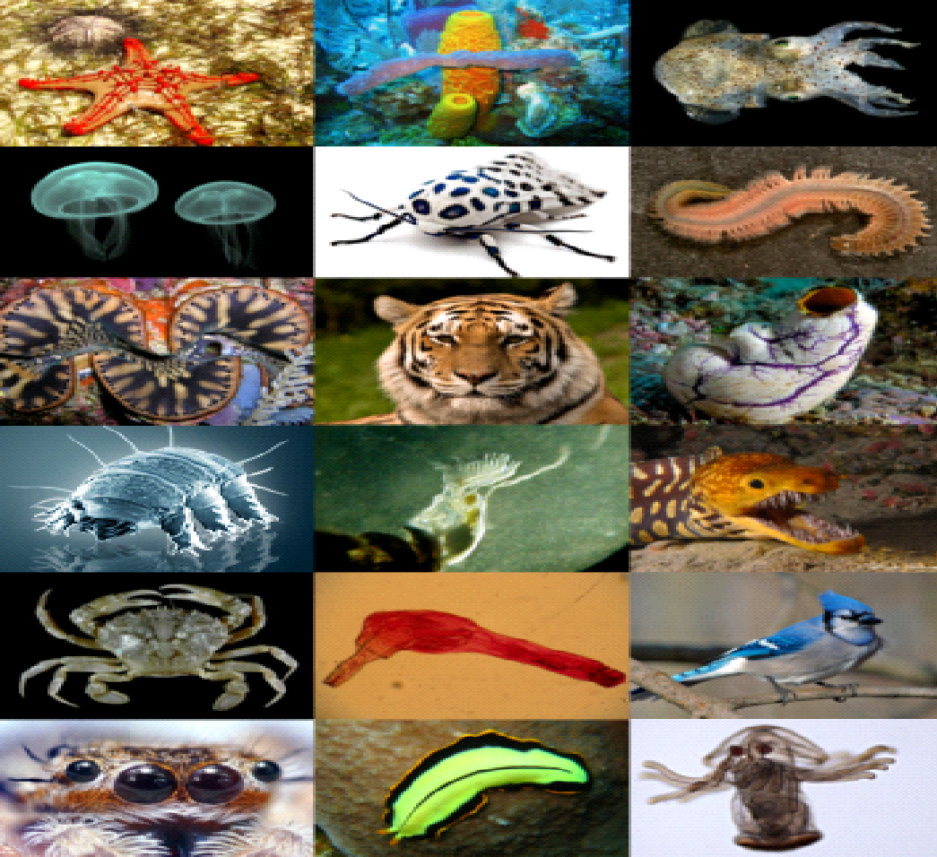
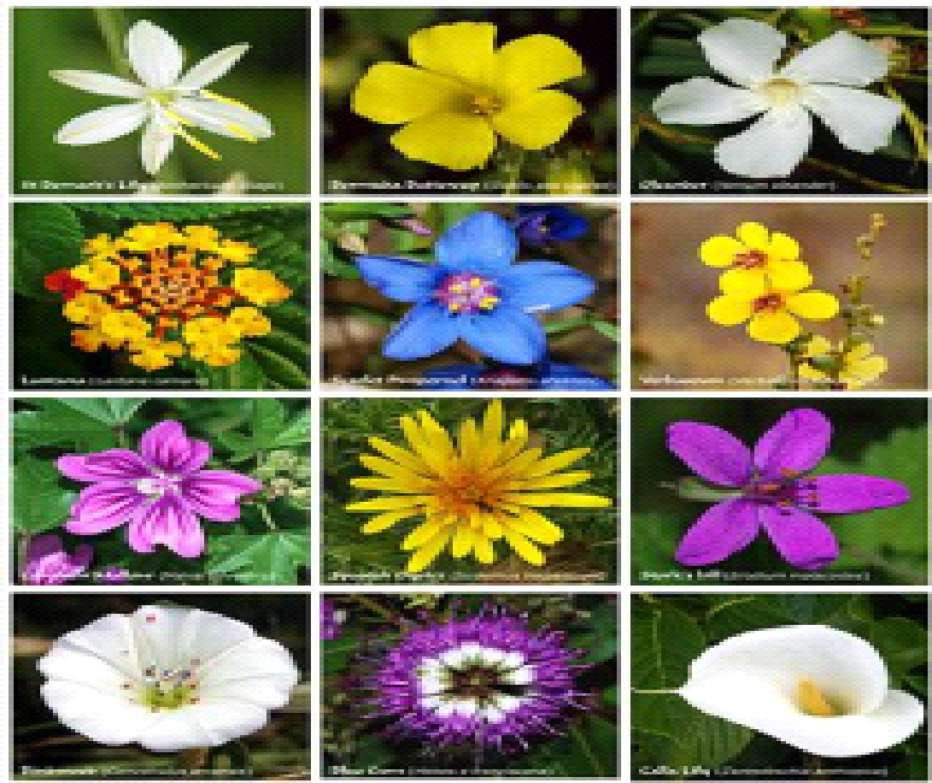
Nature has created diversity

Slide 12
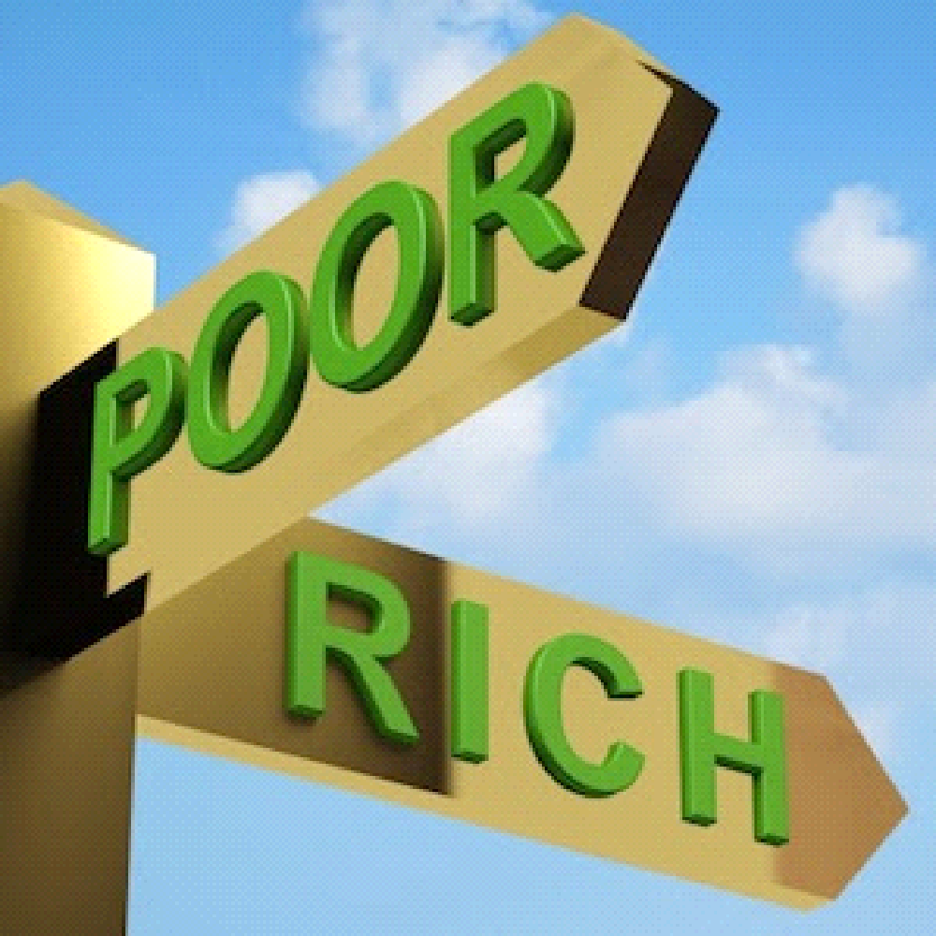
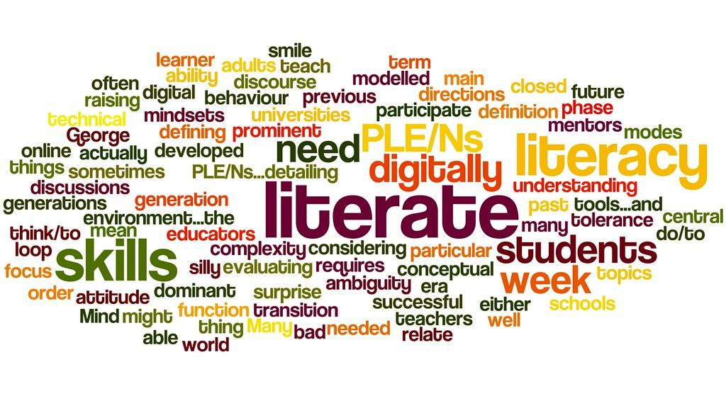
What is inequality? Is it same to diversity?

Slide 13
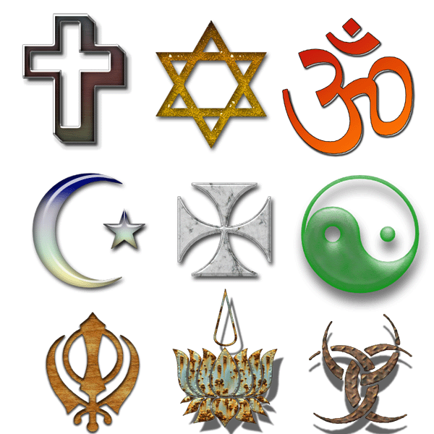
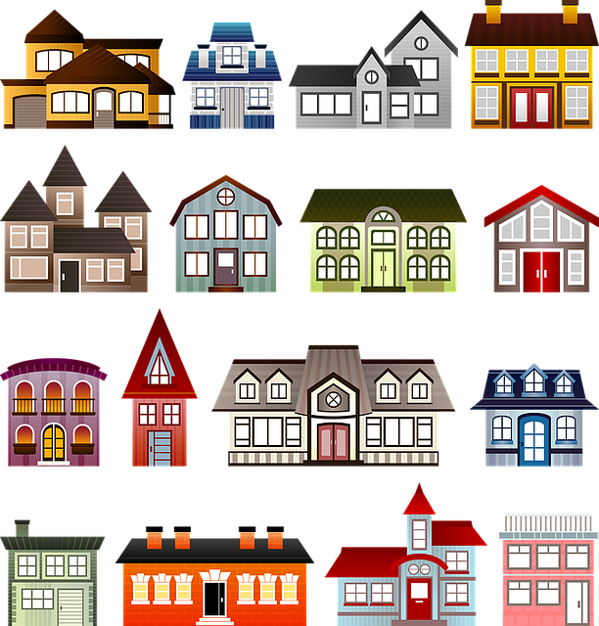
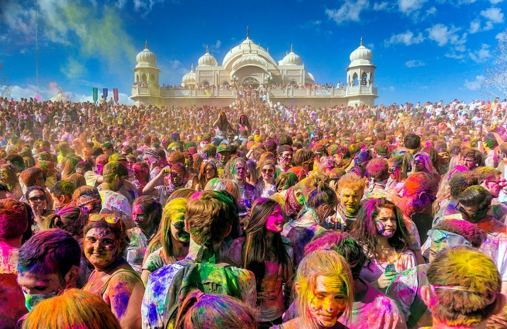
Diversity created and maintained by human being

Slide 14
Cultural assimilation
Transport- bus/aeroplane/train from sheep/camel/foot
Moved due to famine/drought/trade/job/war
Regions became unique due to unique history
City- people depend on market while countryside people depend on farms-geographical factors

Slide 15
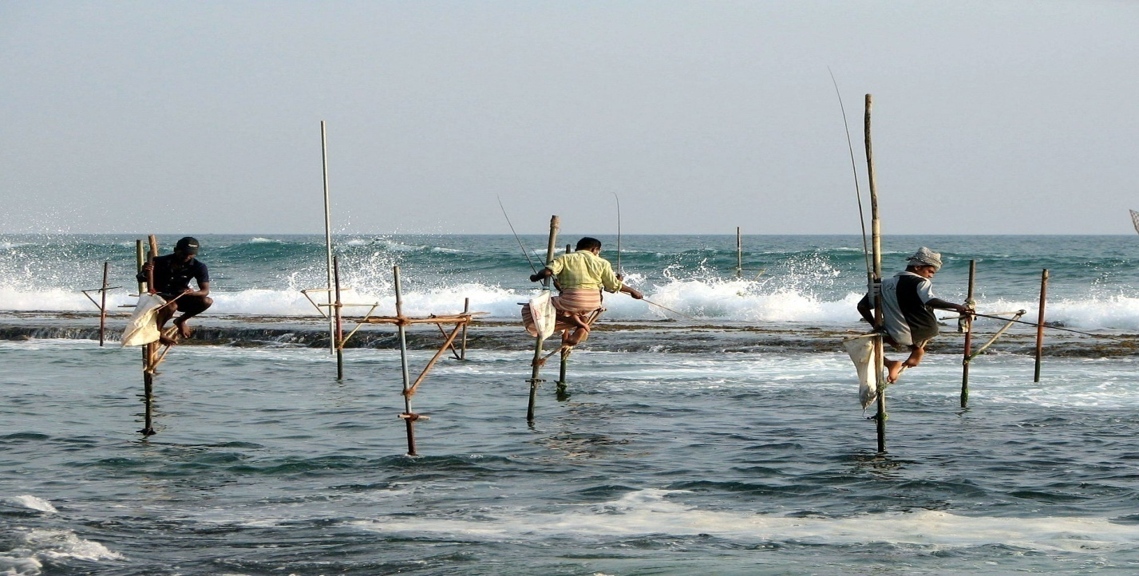
Goa people are catching fish because of their location near sea.

Slide 16
Kerela
Surrounded by seas
Pepper, cardamom and cloves
Jews and arabs came first
Spreaded Christianity
Ibn Batuta wrote about life of muslims
Vasco da Gama came from Portugal
Fishing nets-Chinese-Cheena-vala(utensils to fry- cheenachatti)
Rice and fish

Slide 17
Diversity is the result of History and Geography of any area-
Kerala people do boat race because of their location near sea. It is also known as VallamKali.

Slide 18
LADAKH
Cold desert
Water from melting snow
Sheep- pashmina wool
Meat and milk-goats, cows dzos(yak cows)
Trade route for caravans- tibet- textile, spices and silk
Buddhism and Islam
Rich in songs and poems

Slide 19
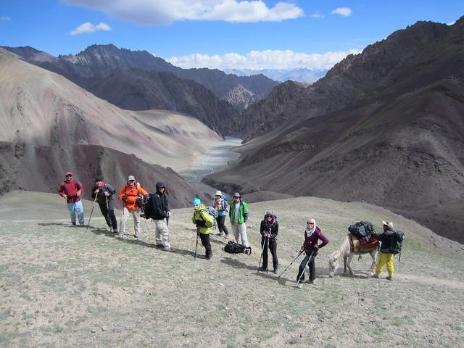
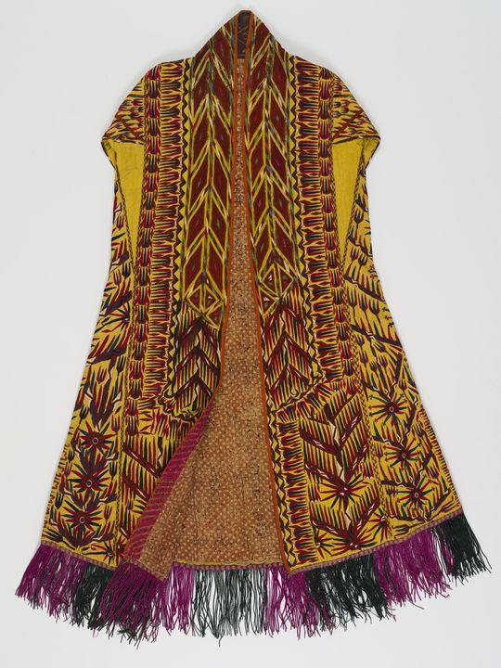
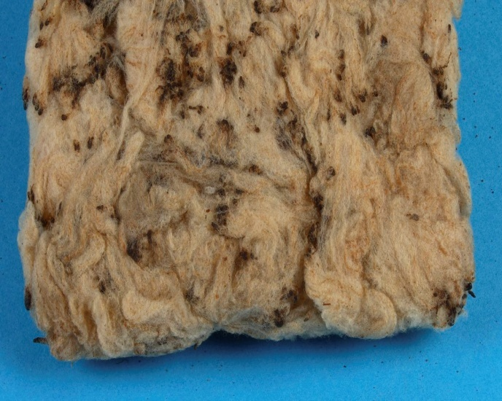
Laddakh people are famous for producing wool and making Pashmina shawl.

Slide 20
Unity in Diversity
Independence movement in India
Divide and rule- failed
General Dyre- Jallianwala Bagh Massacre- Hindus and Muslims, rich and poor
Songs and symbols and anthem(by Rabindranath Tagore)
Discovery of India by Nehru- unity is from within- tolerance and compassion- he phrased the word “unity in diversity”

Slide 21
THE END

